Slide 1
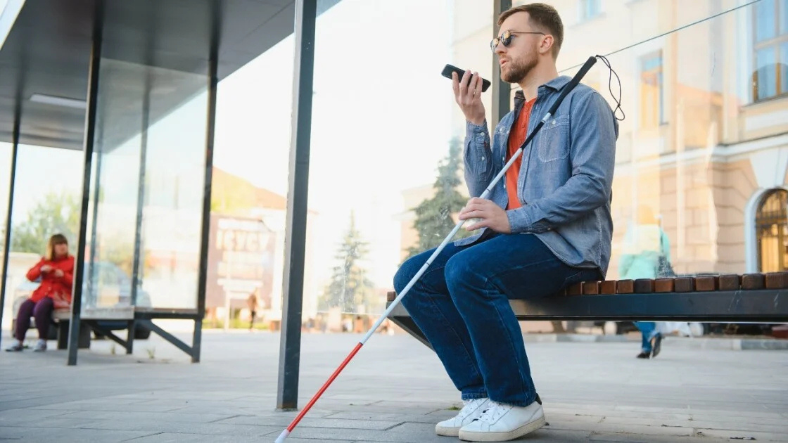

OBJECT DETECTION & AUDIO FEEDBACK SYSTEM FOR THE VISUALLY IMPAIRED
Tresa Nancy Thareparambil Paul
Group_4

Slide 2

Introduction
Smart Navigation for the Visually Impaired!
A smartphone-based solution that detects obstacles using the phone camera
Provides real-time audio feedback for safe and independent mobility
No extra hardware needed – accessible, affordable, and easy to use

Slide 3
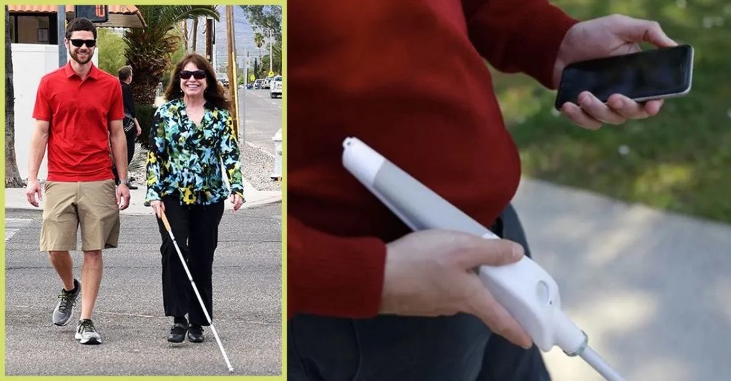
OBJECTIVE
Enhance Mobility
Real time obstacle detection
Audio Feedback system
Cost Effective and Accessible
Improve Safety

Slide 4



PROPOSED METHODOLOGY
Image Capture
Obstacle Detection
Audio Feedback
Real-time snapshots are continuously taken by the smartphone's camera.
Computer vision algorithms examine the photos to find obstructions
Real-time voice alerts inform the user about the obstacle

Slide 5

01
Smartphone (Camera for live video streaming)
SYSTEM OVERVIEW
02
Laptop (Processing and object recognition)
03
Google Remote Desktop (Remote control)
04
IP Webcam (Stream phone camera to laptop)
05
Audio Relay (Stream audio to smartphone)

Slide 6

TECHNOLOGIES USED
Image Capture | | (IP Webcam)
Obstacle Detection | | (OpenCV & Torch)
Audio Feedback | | (Pyttsx3, Audio Relay)
User Response

Slide 7

SYSTEM WORKFLOW
Start IP Webcam on Phone
Laptop Processes Video Using OpenCV & Torch
The smartphone camera is used to capture live video and stream it over Wi-Fi.
Objects Detected Using: OpenCV & Torch (Deep Learning)
The system analyzes the video frame-by-frame to identify objects in real time.
Phone Streams Video to Laptop
The video feed is transmitted to the laptop for processing using the IP Webcam app
Objects Converted to Speech
Audio Streamed to Phone via Audio Relay
Converted to Speech Using: Pyttsx3 (Text-to-Speech Engine)
The detected objects' names are spoken out loud to the user.
The voice feedback is sent back to the phone so the user can hear the detected objects clearly.

Slide 8

IMPLEMENTATION DETAILS
Setting Up IP Webcam & Google Remote Desktop
Install IP Webcam on the smartphone to stream live video.
Access the video feed using OpenCV on the laptop via the IP address.
Use Google Remote Desktop for remote access if needed.
Python Code for Object Detection
Utilize OpenCV for video capture and frame processing.
Apply a pre-trained ResNet-50 model from PyTorch for real-time object recognition.
Convert the top detected object into meaningful labels.
Using Text-to-Speech for Audio Feedback
Integrate Pyttsx3 for offline speech synthesis.
Speak out the detected object every 5 seconds to avoid spam.
Use Audio Relay to stream the voice output back to the smartphone

Slide 9
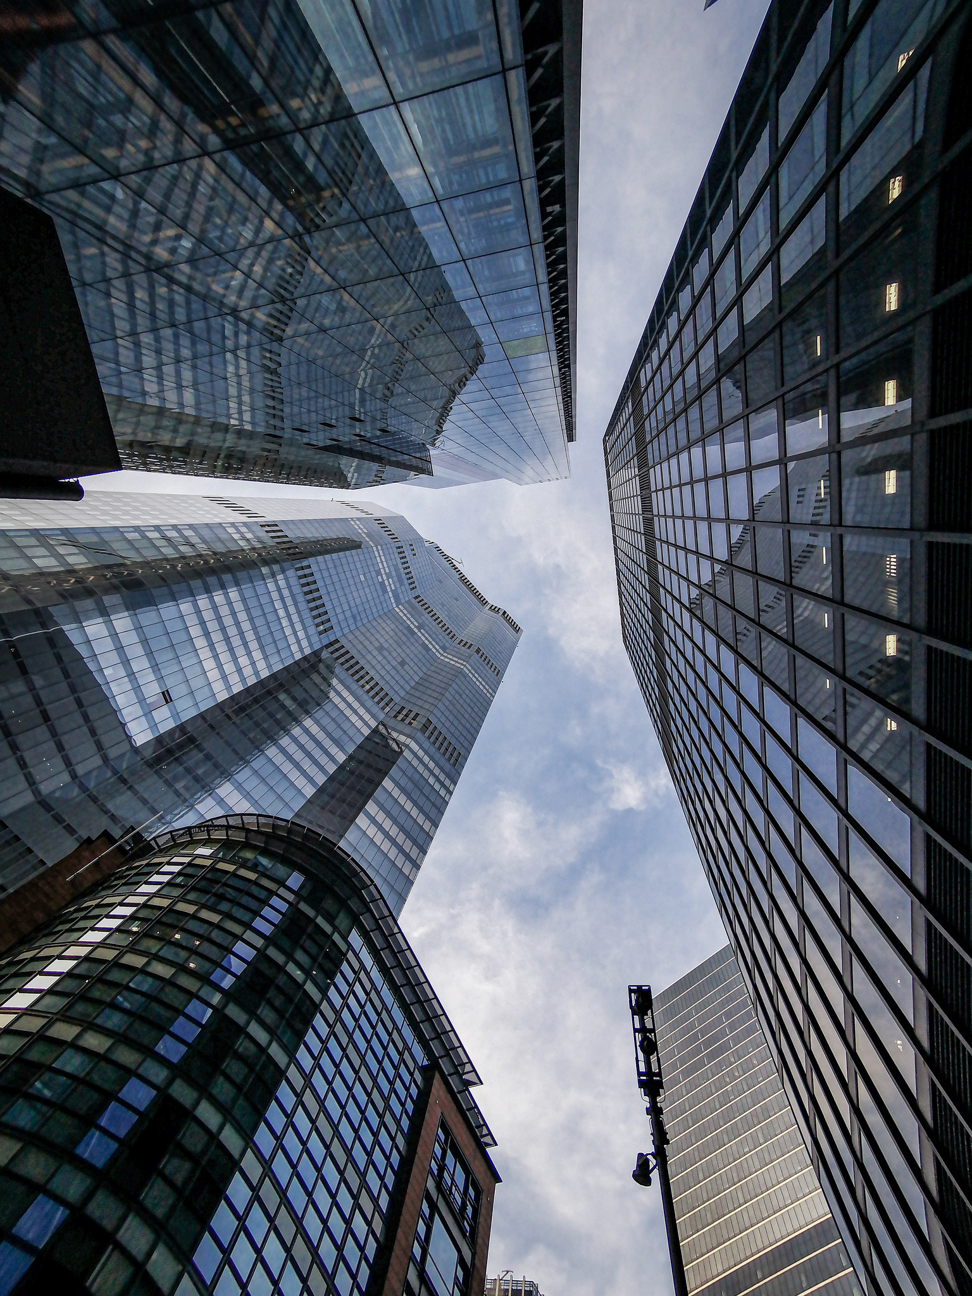
LIMITATIONS
04
Background Noise - Audio feedback may be difficult to discern in cacophonous settings.
01
Internet Dependency – Requires a stable internet connection for video streaming.
05
Battery Consumption - Continuous video streaming and processing rapidly depletes battery life.
02
Latency Issues – Processing delays may occur due to network speed and computational load.
06
Hardware Constraints - Performance is contingent upon the laptop's computational capacity.
03
Limited Accuracy – Object detection may misidentify objects, especially in low-light conditions.

Slide 10



FUTURE IMPROVEMENTS
Improve object detection precision through the integration of sophisticated AI models.
Improve battery efficiency for longer usage time.
Integrate offline capabilities to diminish reliance on internet connectivity.
Develop a dedicated mobile app for seamless integration.
Optimize computational efficiency for smoother real-time processing.

Slide 11
CONCLUSION
This project demonstrates a cost-effective, smartphone-based obstacle detection system.
It uses artificial intelligence and text-to-speech to assist visually impaired people.
While successful, issues like as internet dependency and accuracy can be addressed.
Future advances could improve performance and usability
Overall, this solution provides a foundation for accessible assistive technology

Slide 12

THANK YOU

